Slide 1

Wildfire Prevention – Farmer’s Insurance
By Matt Q.
Consulting/Programming
19th November 2020

Slide 2
Possible Factors to Consider
Wildfire History
Types of Home Resistances
Defensible Space

Slide 3
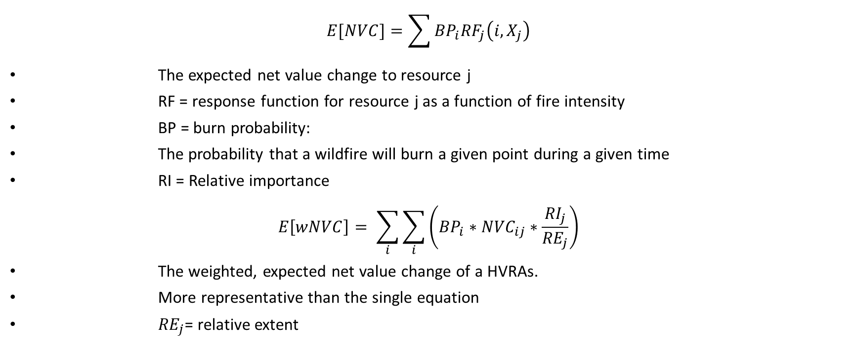
The Weighted Expected Net Value Change
$$E[NVC]=\sum{{BP}_{i}{RF}_{j}\left(i, X_{j}\right)}$$
The expected net value change to resource j
RF = response function for resource j as a function of fire intensity
BP = burn probability:
The probability that a wildfire will burn a given point during a given time
RI = Relative importance
$$E\left[wNVC\right]= \sum_{i}{\sum_{i}{\left({BP}_{i}∗{NVC}_{ij}∗\frac{{RI}_{j}}{{RE}_{j}}\right)}}$$
The weighted, expected net value change of a HVRAs.
More representative than the single equation
${RE}_{j}$= relative extent

Slide 4
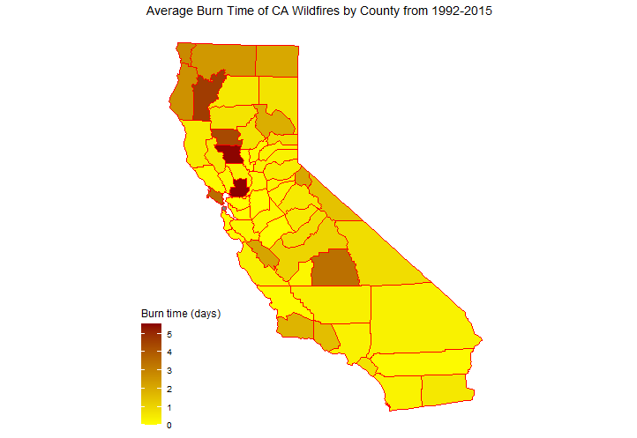
Previous Wildfire History
Number of Wildfires since 1992
Amount of Acreage burned since 2000
Likelihood of wildfire hazard via GIS
Lightning Strike History
NOAA
During these two months (July and August), 91% of the total fires were lightning caused (Conedera et al. 2006)
Map made in R (ggplot2)

Slide 5
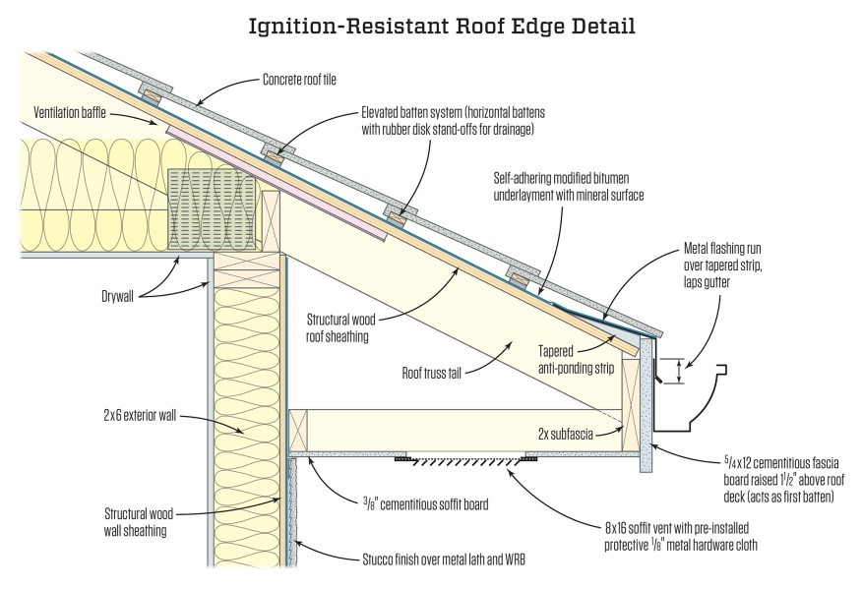
Types of Home Resistances
Buildings surrounded by zones of non-vegetated areas or areas populated by fire-resistant vegetation are more likely to survive
Using non-combustible/fire-resistant materials should be considered

Slide 6
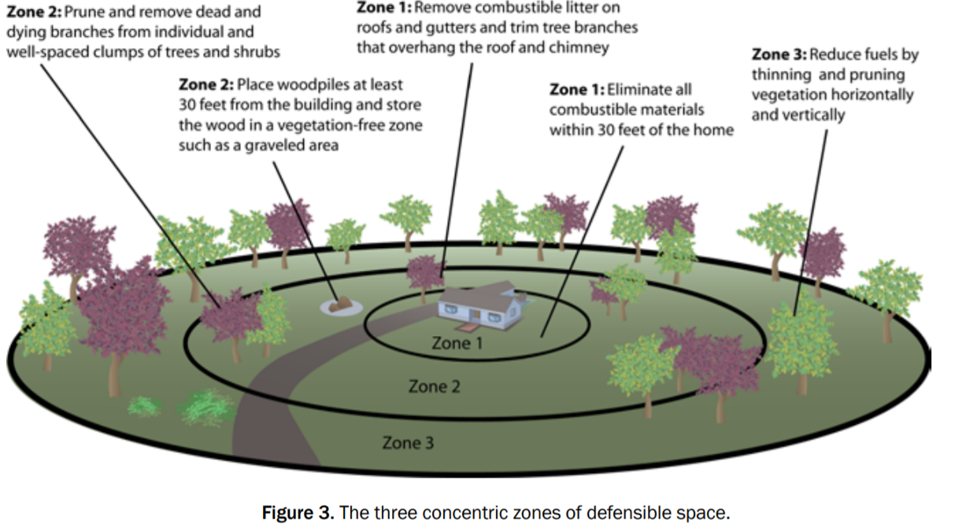
Defensible Space
A defensible space is an area around a building in which vegetation, debris, and other types of combustible fuels have been treated, cleared, or reduced to slow the spread of fire to and from the building
Can be measured via imaging

Slide 7
Sources
https://www.fs.fed.us/rm/pubs/rmrs_gtr315.pdf
https://www.firelab.org/sites/default/files/images/downloads/ArcFuels-help/Content/02Toolbar/05-05%20-Risk.htm
https://www.kaggle.com/captcalculator/wildfire-exploratory-analysis
https://landfire.cr.usgs.gov/viewer/
https://www.fs.fed.us/psw/publications/knapp/psw_2017_knapp001_estes.pdf
https://www.ncbi.nlm.nih.gov/pmc/articles/PMC5313183/
https://hal.archives-ouvertes.fr/hal-00860797/document
https://twitter.com/cstats1/status/1326571601765216257
https://www.fema.gov/media-library-data/20130726-1728-25045-1351/home_builders_guide_to_construction_in_wildfire_zones.pdf
https://www.remodeling.hw.net/business/construction/wildfire-resistance-focus-on-the-roof-edge_o

